Slide 1

SCHOOL OF COMPUTING
DEPARTMENT OF COMPUTER SCIENCE & ENGINEERING
20234CS701- PROJECT PHASE-I
WINTER SEMESTER 2023-2024
REVIEW - II
“No code economic data analysis and sector wise
forecasting using AI”
SUPERVISED BY
Dr. R. Aruna
PRESENTED BY
Austin Indrapaul A (VTP4026 / 23PEBD0001)

Slide 2
AGENDA
ABSTRACT
OBJECTIVE
INTRODUCTION
LITERATURE REVIEW
DESIGN AND METHODOLOGIES
ALGORITHMS/TECHNIQUES USED
IMPLEMENTATION
TESTING
INPUT AND OUTPUT
PERFORMANCE COMPARISON
CONCLUSION
REFERENCES

Slide 3
ABSTRACT
This project introduces a sophisticated no-code solution tailored for comprehensive data analysis and visualization. This innovative initiative is designed to empower users to gain insights on data, without the need of writing a code. By leveraging these we will analyze economic data for a country and create an AI model which uses real time information. Through the integration of some advanced technologies such as React, Flask, and Python, our web-based application delivers an interactive and user-friendly platform for conducting in-depth analysis on this dataset by end users. The bull or bear run of sectors such as real estate, energy, FMCG etc. can be forecasted with the analyzed data using the AI model. The app will feature MVC architecture to improve scalability and easier maintenance. This project can help to understand a country's economic position, movement, pattern and its impact on various sectors based on several factors, and it can predict the future trends.

Slide 4
OBJECTIVES
The primary focus of this project is to provide a no code solution to perform analysis on economic dataset. we will be performing below activities in Phase 1 to achieve it.
Creating the machine learning model.
Developing a app with user friendly UI to do the analysis without any hassle.
Integrating the app with the ML model.

Slide 5
INTRODUCTION
Economic datasets provide valuable insights into the levels and changes in economic activity, such as gross domestic product (GDP), consumption, investment, international trade, and stability indicators like government budgets, prices, money supply, and balance of payments
By analyzing economic datasets, policymakers and researchers can identify economic problems, such as recessions, inflation, unemployment, and income inequality. These datasets help in understanding the root causes of these problems and formulating appropriate policies to address them.
We will be building a web application using React, Flask, and Python. Our web-based application delivers an interactive and user-friendly platform for conducting in-depth analysis on this dataset by end users.

Slide 6
LITERATURE REVIEW
Nozari, H., & Sadeghi, M. E, Artificial intelligence and Machine Learning for Real-world problems (2021). International Journal of Innovation in Engineering,1(3), 38-47
Gives insights on how to use and optimize ML model
Myron P. Gutmann, Emily Klancher Merchant and Evan Roberts, The Journal of Economic History (2018) , Volume 78 , Issue 1
Gives insights on economy, patterns and movement

Slide 7
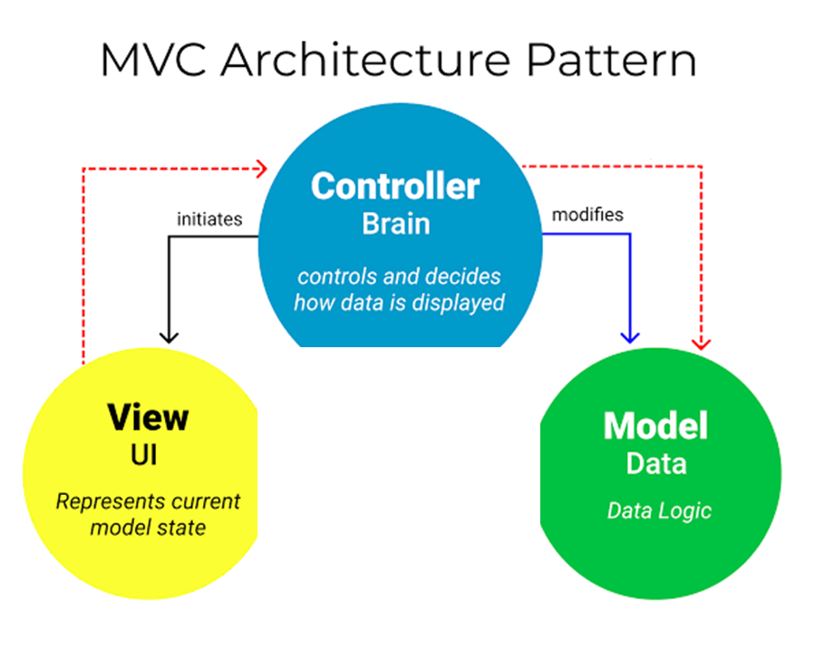
DESIGN AND METHODOLOGIES
The app will feature MVC architecture to improve scalability and easier maintenance.
every functionality is incorporated as a individual component to support it.

Slide 8
ALGORITHMS/TECHNIQUES USED
First step was to get the clean data set to improve the accuracy of the model. Then the data was fed to train the mail using regression algorithm. The score of the model is improved by feeding more data to train the model.
Each component is developed and tested in a agile way, which makes it more robust and scalable

Slide 9
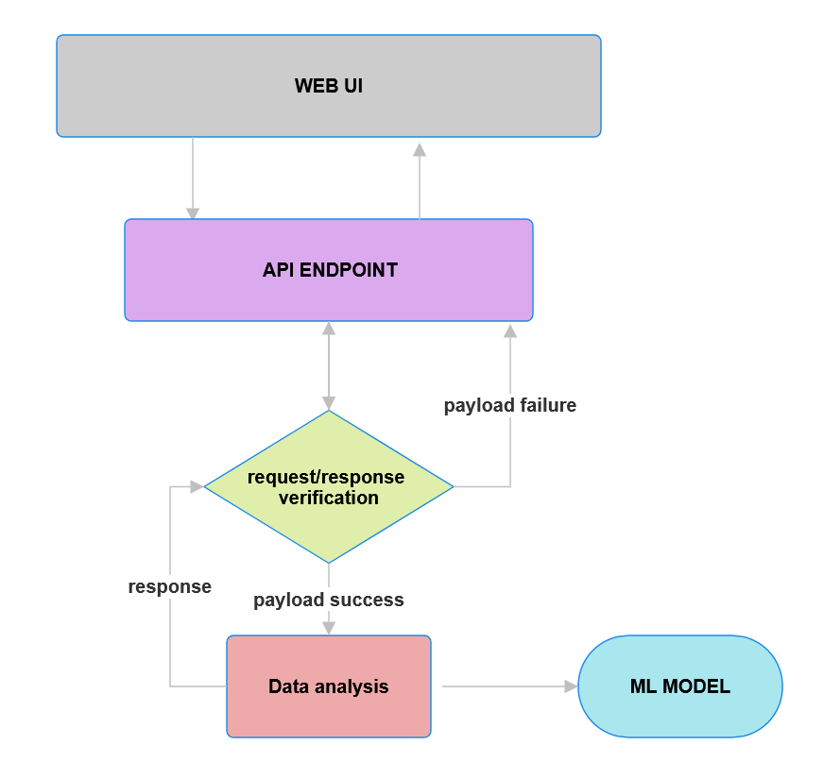
IMPLEMENTATION

Slide 10
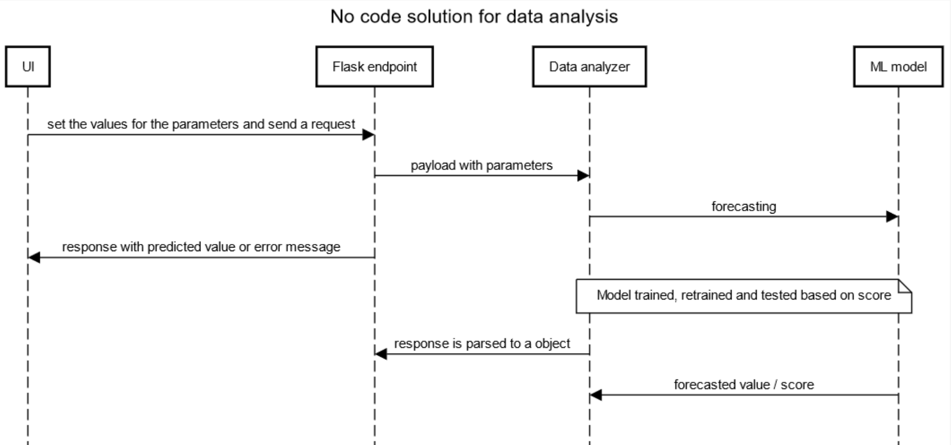
SEQUENCE DIAGRAM

Slide 11
TESTING
UNIT TESTING
The model was first tested with known dataset. It helped to know the accuracy of model.
The generated chart was verified manually.
Individual Components of web application was tested to make sure it works as per the expectation.
API endpoints are checked
INTEGRATION TESTING
In the web application, the same model was integrated and data was fed from UI, and the results were analyzed.
Output of both success and error scenario are verified
WHITE BOX TESTING
Application is launched in debug mode and then logs at each level and payload are verified
BLACK BOX TESTING
The application is tested with known and unknown dataset, then output is captured and verified. The application and model is also put under load testing, tested with parallel requests and application should work fine.

Slide 12
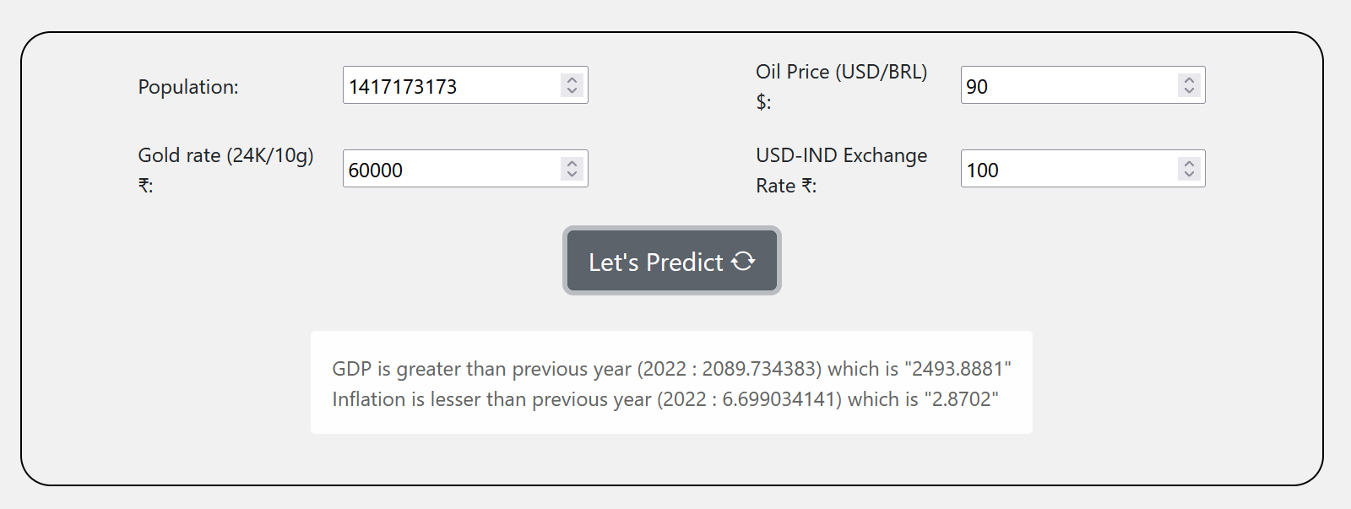
INPUT AND OUTPUT SCREENSHOTS

Slide 13
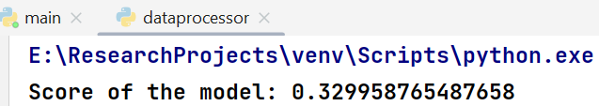
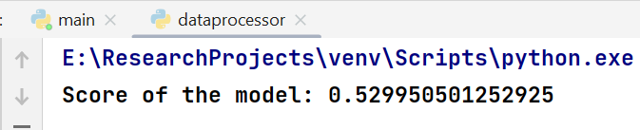
PERFORMANCE COMPARISON
Initial score
After adding more data

Slide 14
CONCLUSION
This project can help to understand a country's economic position, movement, pattern and its impact on various sectors based on several factors, and it can predict the future trends. Government can take essential steps to prevent economic crisis and people can be aware of it.

Slide 15
REFERENCES(as per IEEE format only)
Nozari, H., & Sadeghi, M. E, Artificial intelligence and Machine Learning for Real-world problems (2021). International Journal of Innovation in Engineering,1(3), P 38-47
Gives insights on how to use and optimize ML model
Myron P. Gutmann, Emily Klancher Merchant and Evan Roberts, The Journal of Economic History (2018) , Volume 78 , Issue 1
Gives insights on economy, patterns and movement

